Slide 1
GRK 2839 – Winter School 2023 Corpus linguistics: Representation, indexing & corpus queries
Prof. Dr. Stephanie Evert
Chair of Computational Corpus Linguistics
www.linguistik.uni-erlangen.de

Slide 2
Corpus annotation: lemmatization
<s> It_{PP}^{it} seemed_{VBD}^{seem} a_{DT}ª day_{NN}^{day} much_{RB}^{much} as_{IN}^{as} any_{DT}^{any} other_{JJ}^{other} until_{IN}^{until} I_{PP}^{I} happened_{VBD}^{happen} to_{TO}^{to} look_{VB}^{look} out_{RP}^{out} of_{IN}^{of} the_{DT}^{the} back_{JJ}^{back} window_{NN}^{window} ._{SENT}. </s>
<s> There_{EX}^{there} was_{VBD}^{be} a_{DT}ª little_{JJ}^{little} garden_{NN}^{garden} behind_{IN}^{behind} the_{DT}^{the} house_{NN}^{house} ;:; a_{DT}ª well-mown_{VBN}??? lawn_{NN}^{lawn} surrounded_{VBN}^{surround} by_{IN}^{by} a_{DT}ª neatly_{RB}^{neatly} cut_{VBN}^{cut} hedge_{NN}^{hedge} ,,, a_{DT}ª few_{JJ}^{few} bushes_{NNS}^{bush} and_{CC}^{and} colourful_{JJ}^{colorful} flowers_{NNS}^{flower} ._{SENT}. </s>
need better representation format

Slide 3
XML markup of annotation Standard for data interchange & archiving
root element
element annotated with attributes
<corpus>
<story num="6" title="The Garden">
<p>
<s>
<token pos="PP" lemma="it">It</token>
<token pos="VBD" lemma="seem">seemed</token>
<token pos="DT" lemma="a">a</token>
<token pos="NN" lemma="day">day</token>
<token pos="RB" lemma="much">much</token>
<token pos="IN" lemma="as">as</token>
<token pos="DT" lemma="any">any</token>
<token pos="JJ" lemma="other">other</token>
<token pos="IN" lemma="until">until</token>
<token pos="PP" lemma="I">I</token>
</s>
</p>
</story>
</corpus>
start tag of XML element
corresponding end tag

Slide 4
XML markup of annotation Standard for data interchange & archiving
XML declaration
<?xml version="1.0" encoding="UTF-8"?>
<corpus>
<story num="6" title="The Garden">
<p>
<s>
<token pos="PP" lemma="it">It</token>
<token pos="VBD" lemma="seem">seemed</token>
<token pos="DT" lemma="a">a</token>
<token pos="NN" lemma="day">day</token>
<token pos="RB" lemma="much">much</token>
<token pos="IN" lemma="as">as</token>
<token pos="DT" lemma="any">any</token>
<token pos="JJ" lemma="other">other</token>
<token pos="IN" lemma="until">until</token>
<token pos="PP" lemma="I">I</token>
...
</s>
</p>
</story>
</corpus>

Slide 5
XML markup of annotation Standard for data interchange & archiving
<?xml version="1.0" encoding="UTF-8"?>
<corpus>
<metadata>
<author>
<name>Stefan Evert</name>
<sex>male</sex>
</author>
<publication>
<title>Very Short Stories</title>
<type>collection</type>
<genre>fiction</genre>
</publication>
</metadata>
<story num="6" title="The Garden">
<p>
<s>
<token pos="PP" lemma="it">It</token>
<token pos="VBD" lemma="seem">seemed</token>
<token pos="DT" lemma="a">a</token>
<token pos="NN" lemma="day">day</token>
...
metadata header

Slide 6
XML standards
XML (Extensible Markup Language) is a widely-used standard for structured annotation
A well-formed XML document guarantees consistent markup and hierarchical structure, but neither names nor semantics of elements & attributes
DTD (document type declaration) or XML Schema specify valid element & attribute names and their nesting
still doesn't explain semantics without documentation!
Exchange formats for text corpora: TEI (Text Encoding Initiative), XCES (Corpus Encoding Standard), ISO 24612: LAF (Linguistic Annotation Framework)
but simpler and more efficient representation is preferable for corpus search & quantitative analysis

Slide 7
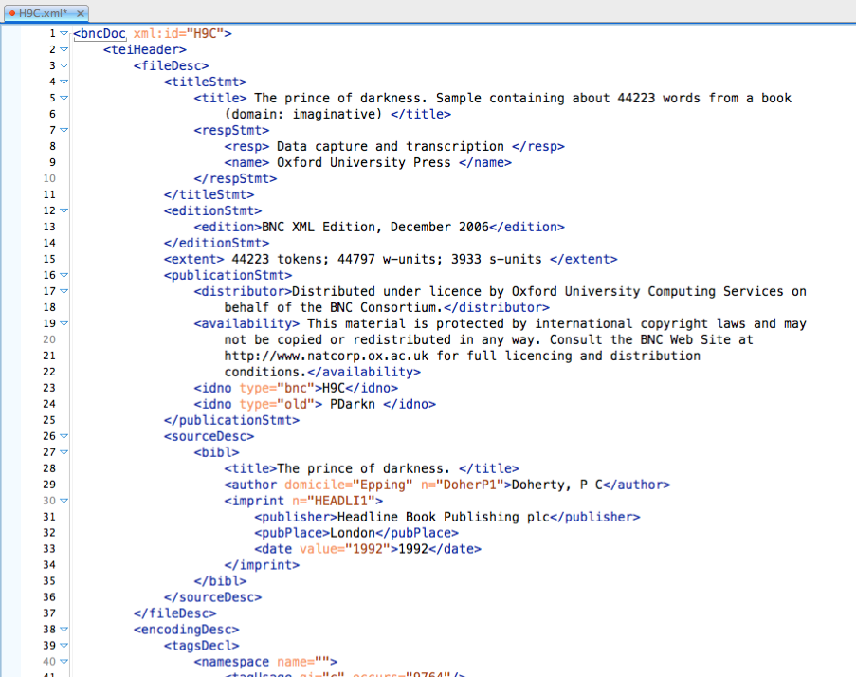
TEI standard (BNC)
TEI header = metadata
text from British National Corpus
information about this text

Slide 8
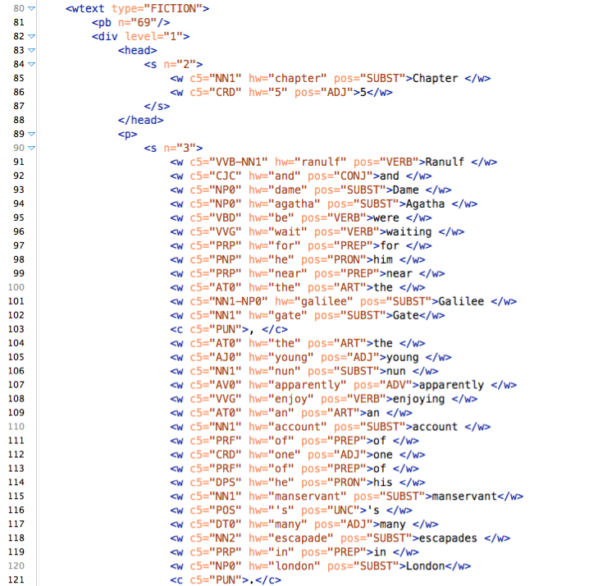
TEI standard (BNC)
TEI body = object data + annotation
structure & typographic markup
tokens + token-level annotations
principle:
raw text (= object data) can be reconstructed by deleting all XML tags

Slide 9
Vertical text format (.vrt) Simpler, more efficient format ➞ used by CWB & NLP tools
<corpus>
<story title="The Garden">
<p>
<s>
It PP it
seemed VBD seem
a DT a
day NN day
much RB much
as IN as
any DT any
other JJ other
until IN until
I PP I
...
</s>
</p>
</story>
</corpus>
metadata
title: The Garden
author: Stefan Evert
author sex: male date: 05.08.1991
TAB characters (\t, \x09)

Slide 10
Vertical text format (.vrt) Text metadata encoded in XML start tags (not in header!)
<corpus>
<text title="The Garden" author="Stefan Evert" author_sex="male" date="1991-08-05">
<p num="1">
<s>
It PP it
seemed VBD seem
a DT a
day NN day
much RB much
as IN as
any DT any
other JJ other
until IN until
I PP I
...
</s>
</p>
</text>
</corpus>
CQPweb requires <text>, SketchEngine prefers <doc>
sub-text level metadata

Slide 11
CoNLL format Vertical text without the metadata
http://universaldependencies.org/docs/format.html
# story: "The Garden"
# paragraph #1
1 It PP it
2 seemed VBD seem
3 a DT a
4 fine JJ fine
5 day NN day
6 . SENT .
1 There EX there
2 was VBD be
3 an DT a
4 elephant NN elephant
5 . SENT .
# this is the end of the file
these are just comments
blank lines = sentence boundaries
token numbers (within sentence)

Slide 12

CWB data model (~ column store) Efficient binary format used by indexing & query tools
# word pos lemma 0 A DET a
1 fine ADJ fine
2 example NN example
3 . PUN .
4 Very ADV very
5 fine ADJ fine
6 examples NN example
7 ! PUN !
corpus position (“cpos”)

Slide 13
CWB data model (~ column store) Efficient binary format used by indexing & query tools
# word pos lemma
(0) <text id="42" lang="English">
(0) <s> 0 A DET a
1 fine ADJ fine
2 example NN example
3 . PUN .
(3) </s>
(4) <s>
4 Very ADV very
5 fine ADJ fine
6 examples NN example
7 ! PUN !
(7) </s>
(7) </text>
XML tags inserted as “invisible” tokens

Slide 14
CWB data model (~ column store) Efficient binary format used by indexing & query tools
p-attributes
# word pos lemma
(0) <text id="42" lang="English">
(0) <s> 0 A DET a
1 fine ADJ fine
2 example NN example
3 . PUN .
(3) </s>
(4) <s>
4 Very ADV very
5 fine ADJ fine
6 examples NN example
7 ! PUN !
(7) </s>
(7) </text>
XML regions
represented
internally as
ranges of
tokens, i.e.
start/end cpos
id="42" lang="English"
s-attributes

Slide 15
CWB data model (~ column store) Efficient binary format used by indexing & query tools
# word pos lemma
(0) <text id="42" lang="English">
(0) <s> 0 A 0 DET 0 a 0
1 fine 1 ADJ 1 fine 1
2 example 2 NN 2 example 2
3 . 3 PUN 3 . 3
(3) </s>
(4) <s>
4 Very 4 ADV 4 very 4
5 fine 1 ADJ 1 fine 1
6 examples 5 NN 2 example 2
7 ! 6 PUN 3 ! 5
(7) </s>
(7) </text>
lexicon IDs for annotation strings (per column)

Slide 16
Corpus query & analysis with CQPweb

Slide 17

Techniques of corpus linguistics: A hands-on example
Goal: Understand this [➞] guy's rhetoric, terminology, phraseology and topics just in case he comes back …
How would you approach this task?
We need a large collection of texts written by Trump, e.g. the Trump Twitter Archive [www.thetrumparchive.com]
Step 1: Compile a linguistically annotated corpus (TTA)
Step 2: Upload to indexing & search engine
Step 3: Analyse with corpus-linguistic techniques

Slide 18
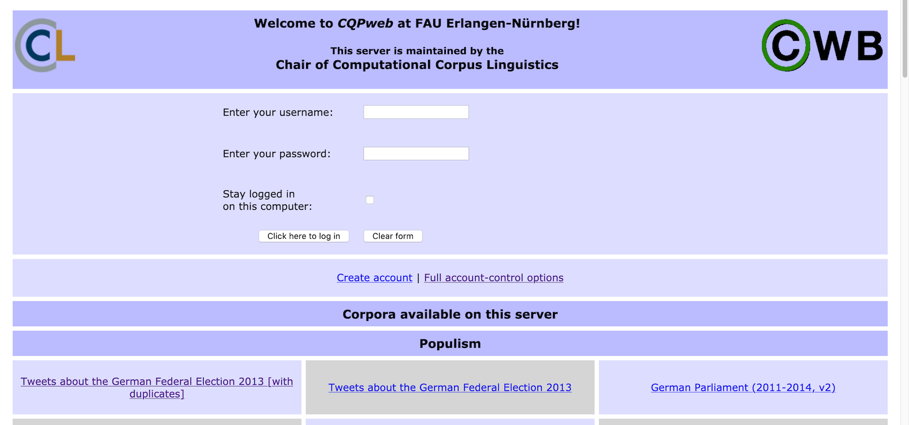
Techniques of corpus linguistics: A hands-on example
Hands-on experience with CQPweb and the Trump Twitter Archive
go to https://corpora.linguistik.uni-erlangen.de/cqpweb/ and login as student1 … student15
select corpus Trump Twitter Archive from “Political Tweets” section

Slide 19
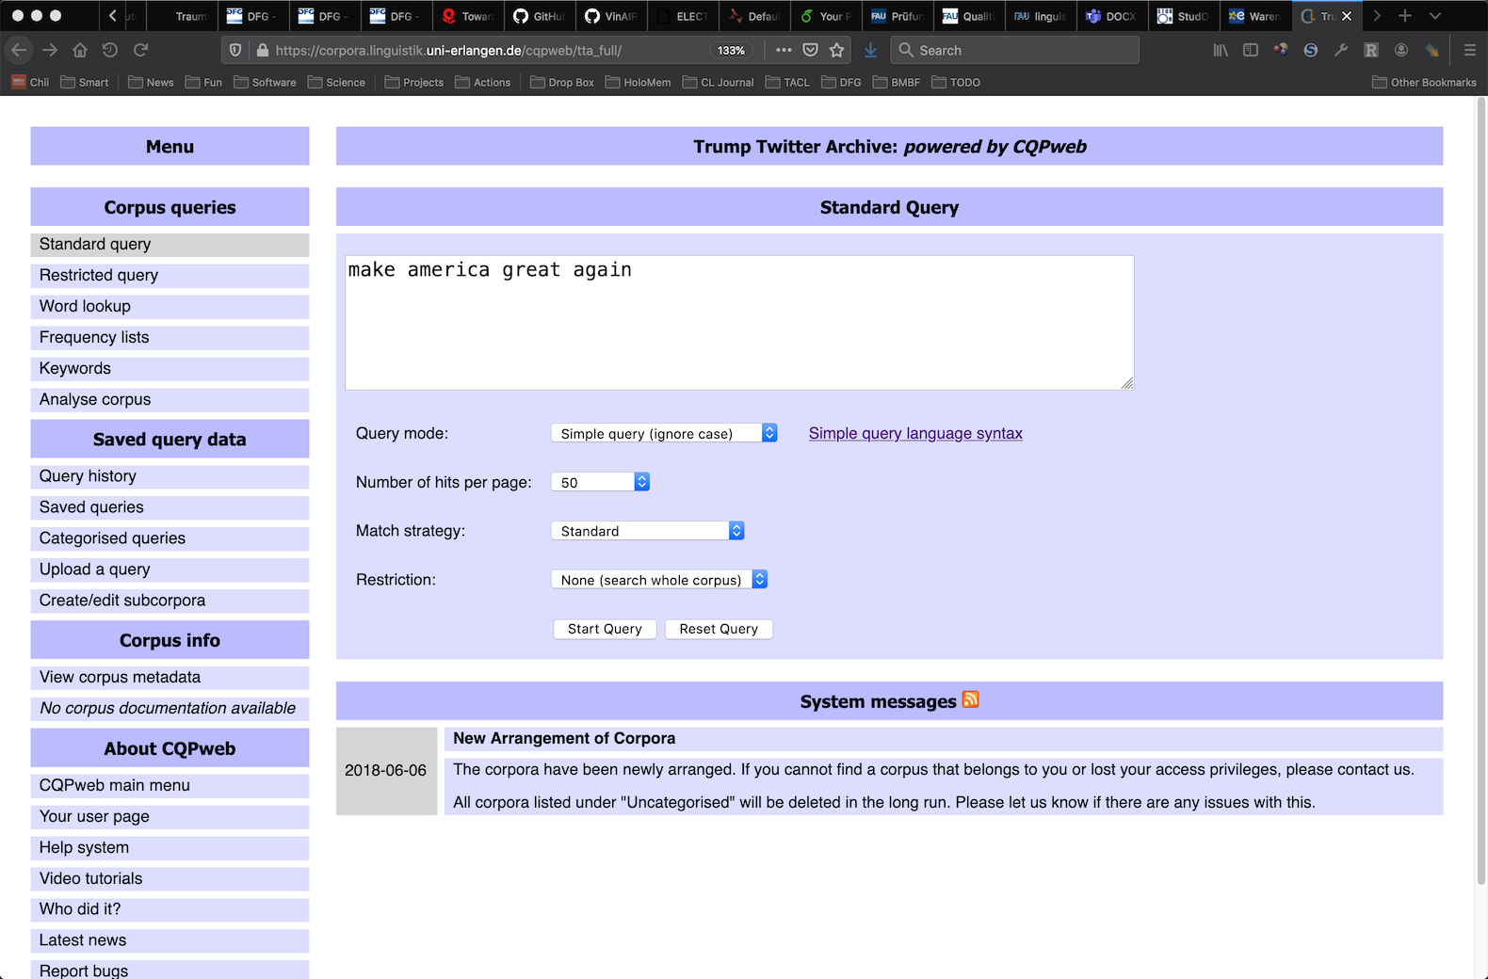
Simple search

Slide 20
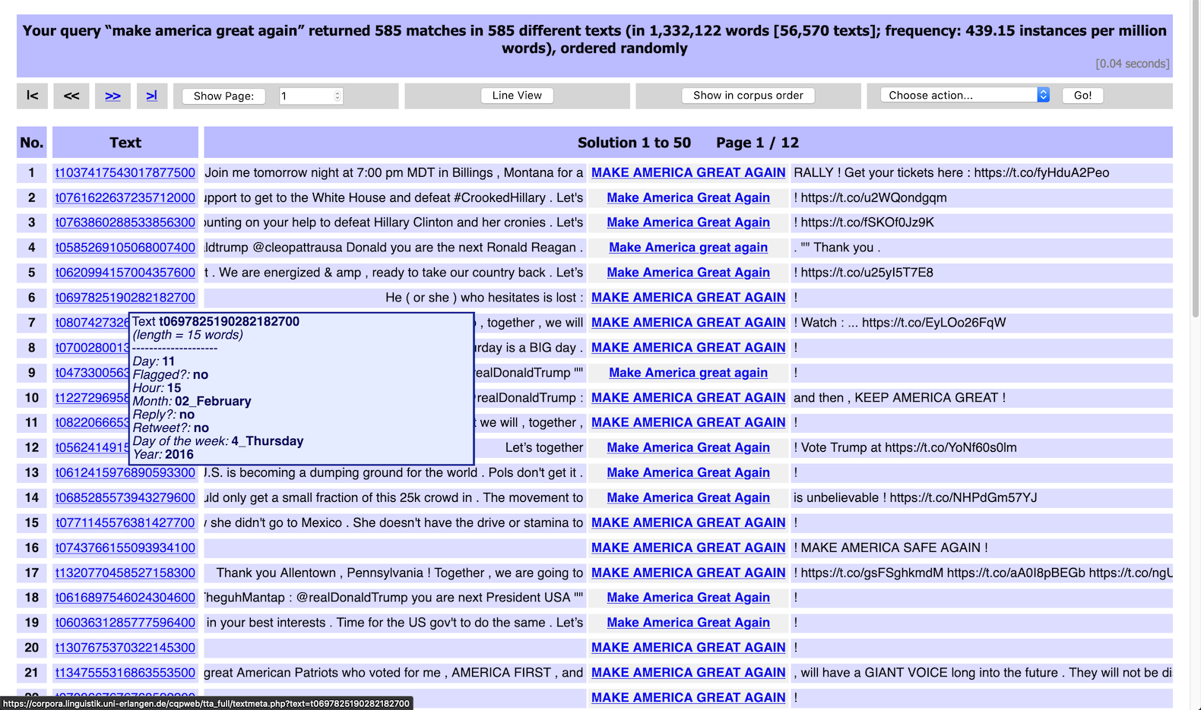
Concordance (kwic = key word in context)
frequency information
random ordering
click for context
click / hover for metadata

Slide 21
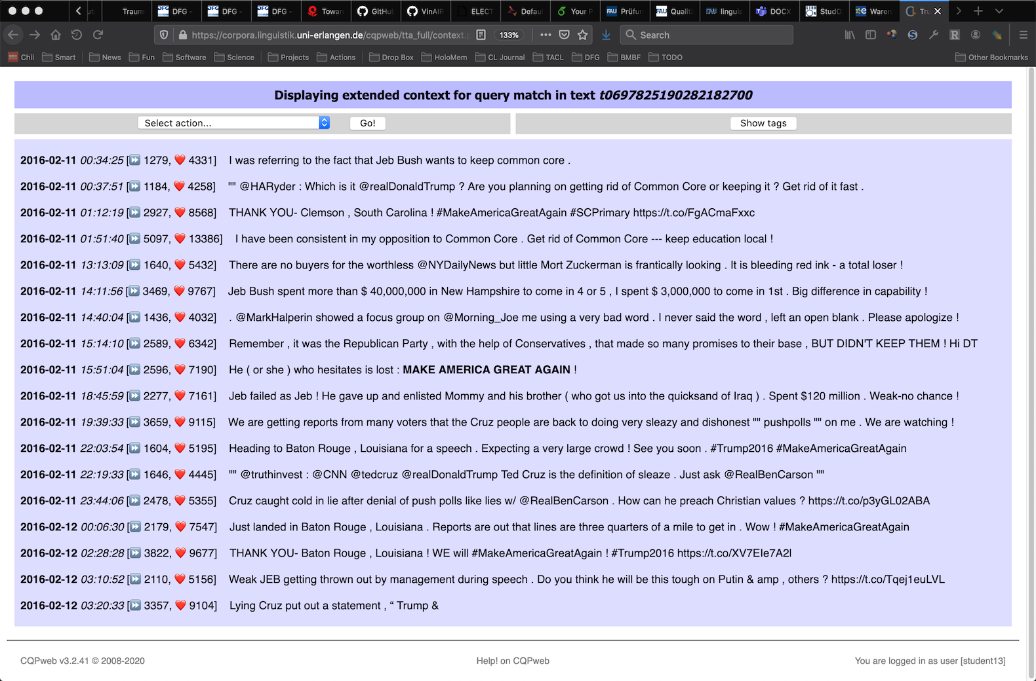
Extended context display with formatting
this is the match

Slide 22
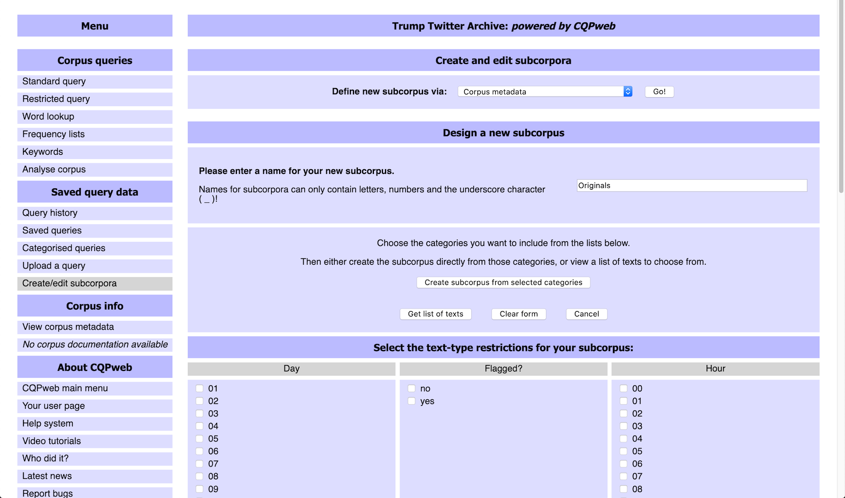
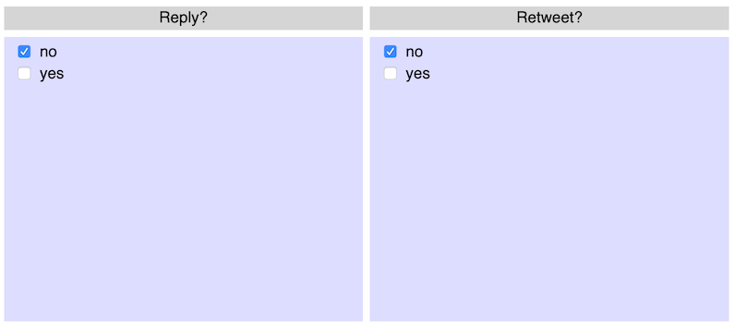
Create subcorpus for targeted search
only original tweets

Slide 23
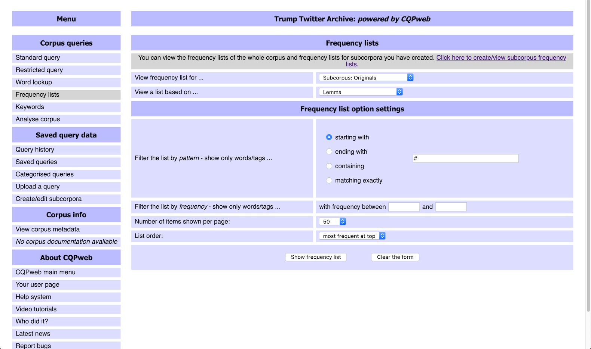
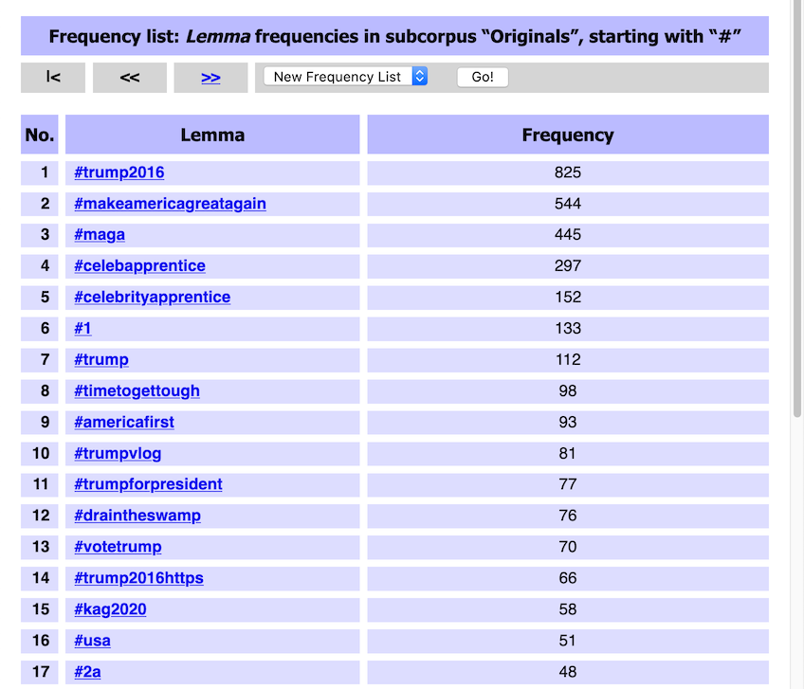
Frequency list for hashtags
must compile frequency list for subcorpus first
hashtags

Slide 24
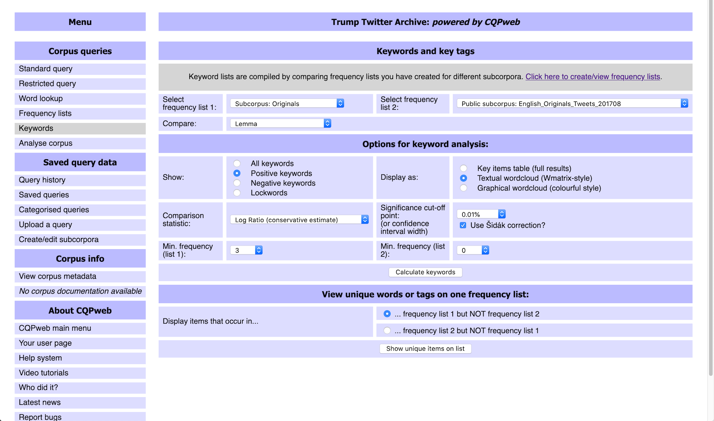
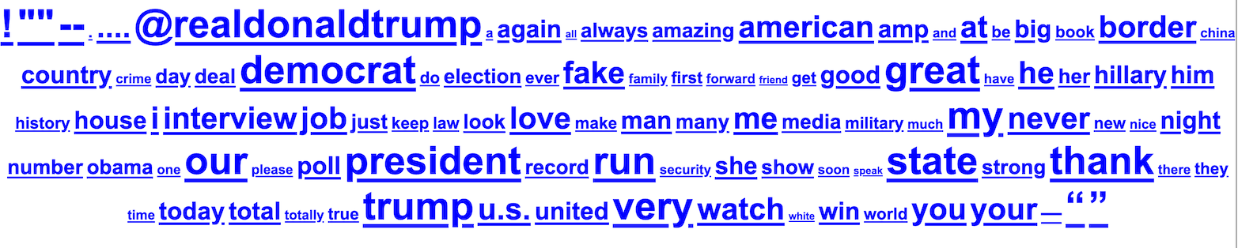
Keywords vs. reference corpus
suitable reference corpus
recommended settings
click for concordance

Slide 25
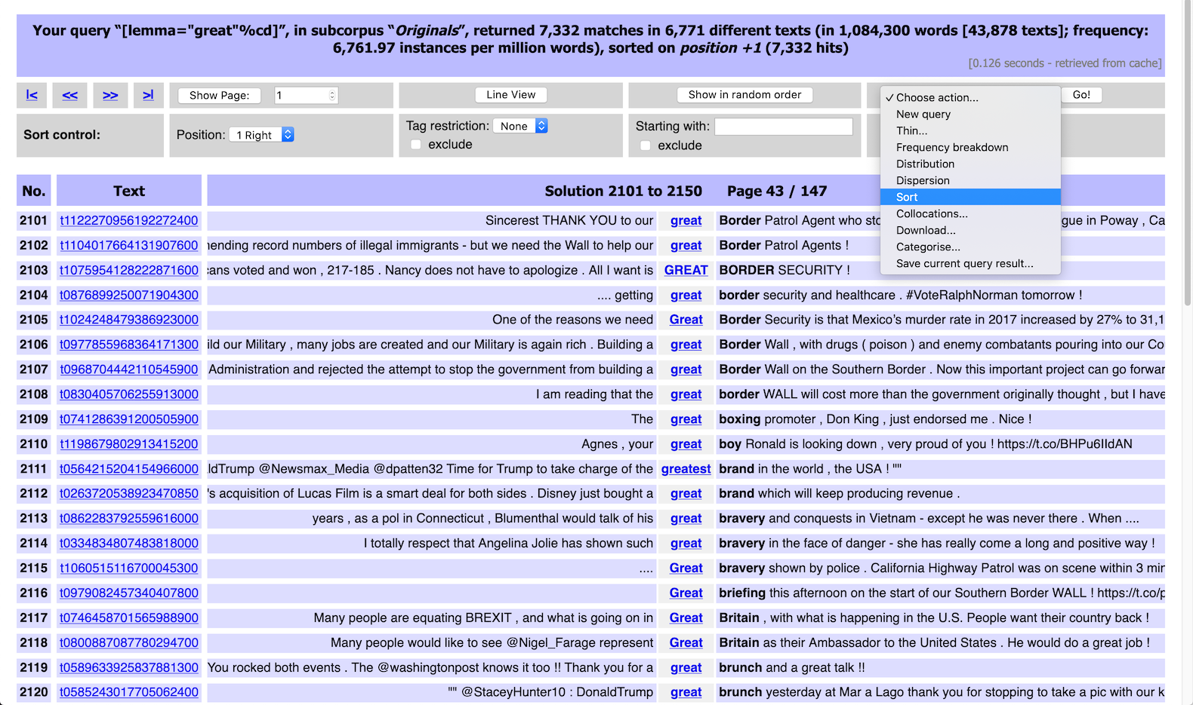
Sorted concordance: great
action menu

Slide 26
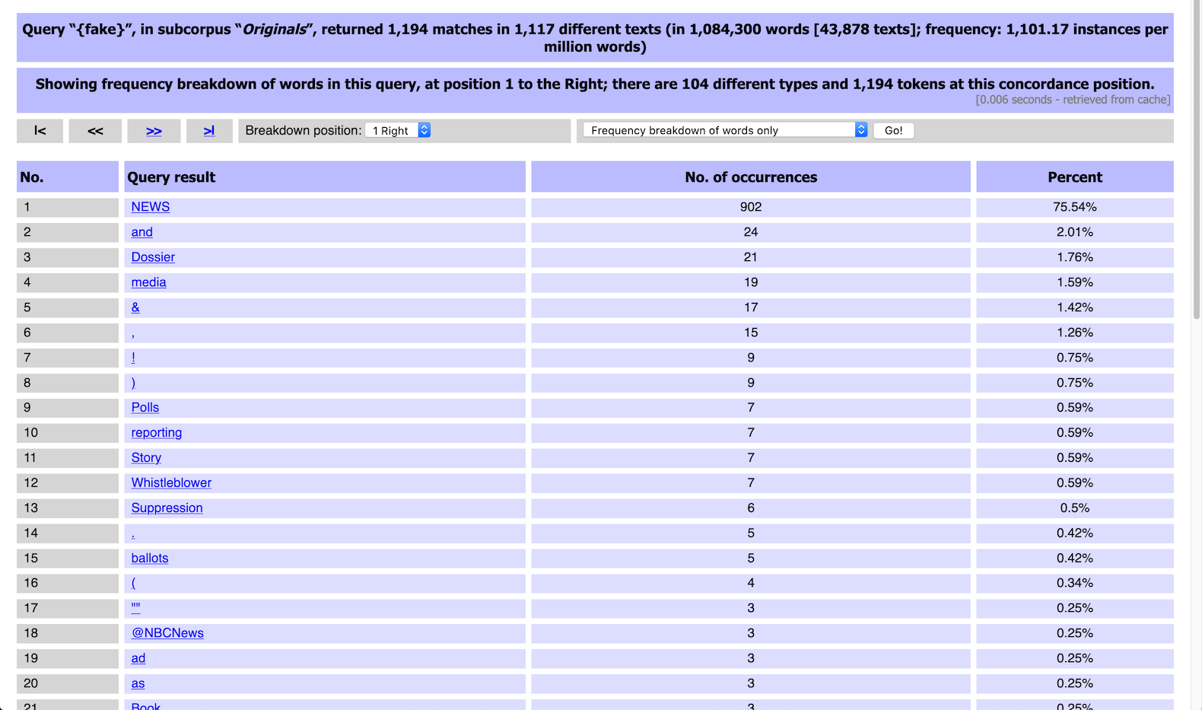
Frequency breakdown: fake
full process history

Slide 27
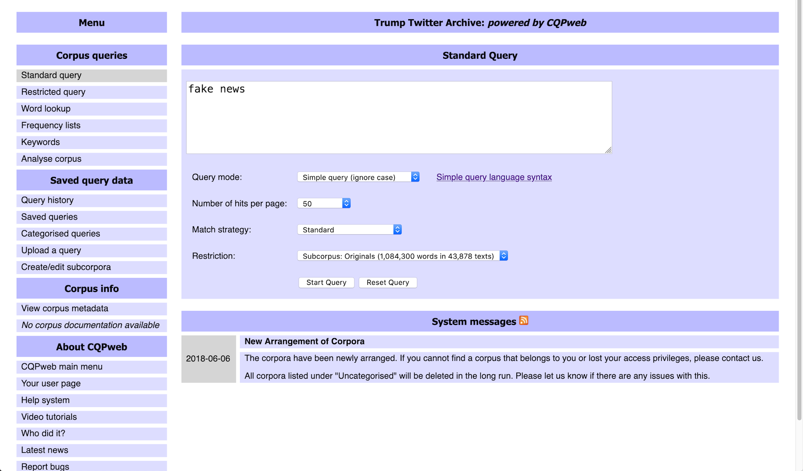
Time for a closer look: fake news

Slide 28
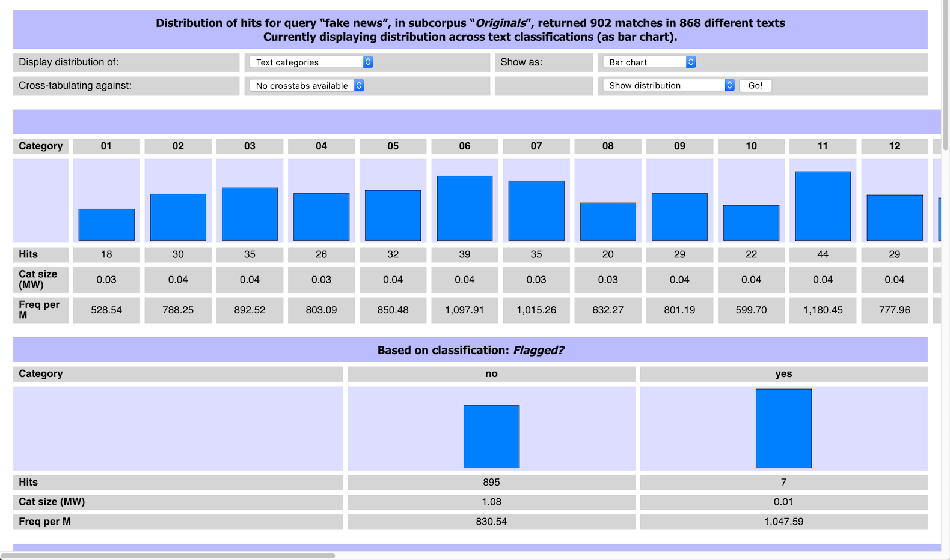
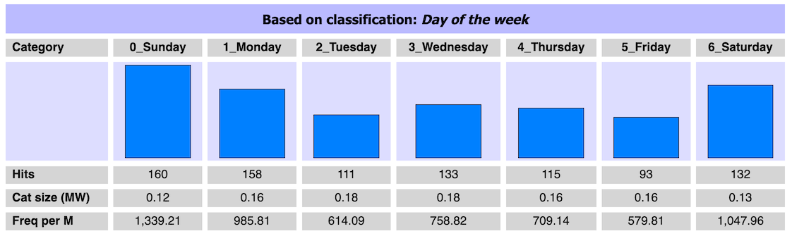
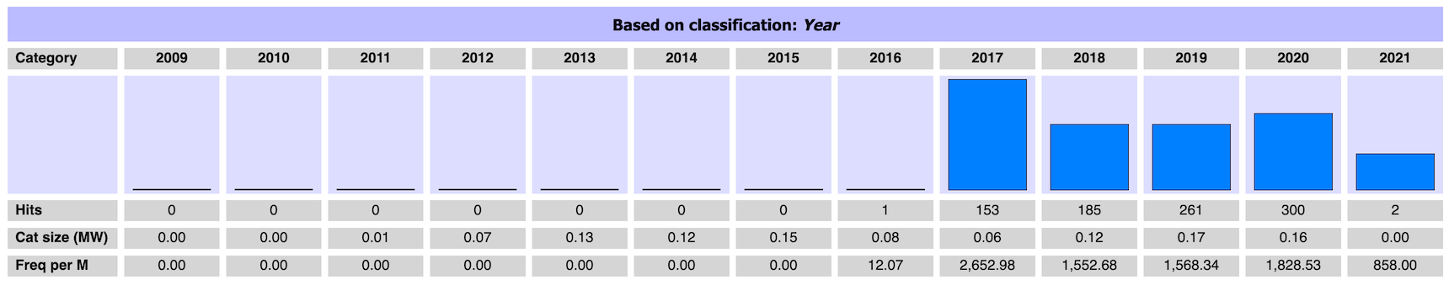
Distribution across metadata categories

Slide 29
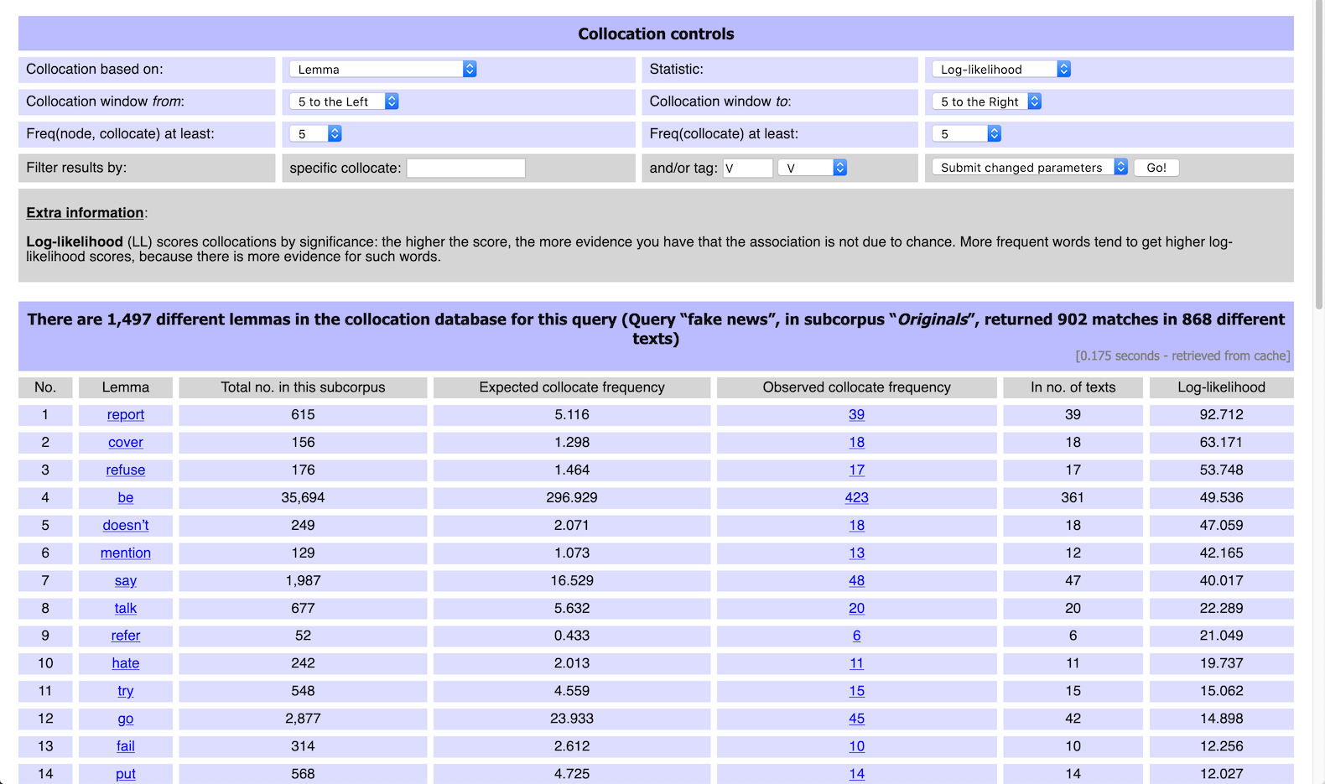
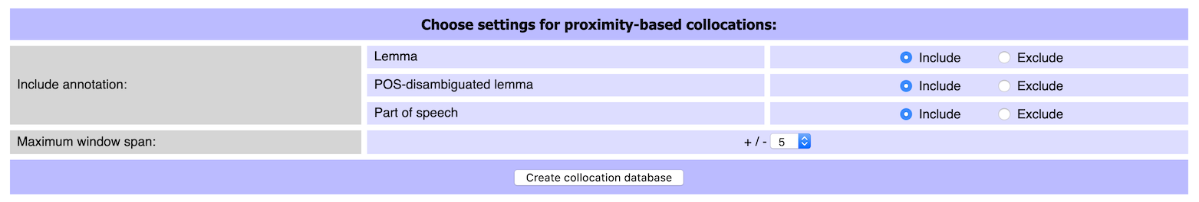
Collocation analysis
key parameters
click for examples

Slide 30
Thank you for listening!

